Slide 1
Virtual Curriculum Night
September 3, 2020

Slide 2
Founder’s Welcome
Founder and CEO
Dr. Tanae Morrison
Notes:
Tanae

Slide 3
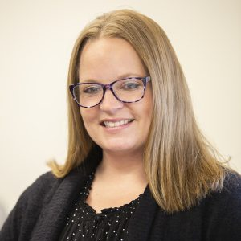
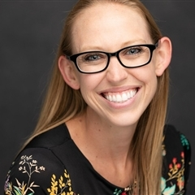
Principal’s Welcome
Amy Austin MA.Ed
South Mountain Campus
Ashlynn Johnson MA.Ed
Avondale Campus
Notes:
Principal

Slide 4
Avondale Campus
SVA Parade

Slide 5
South Mountain Campus
SVA Parade

Slide 6
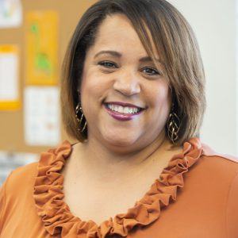
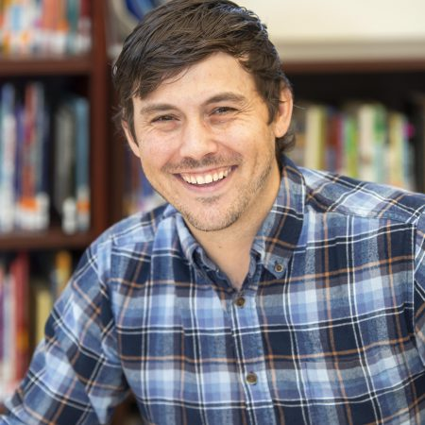
Curriculum Overview
Tina Garrison, MA.Ed Director of
Curriculum & Instruction
Nicholas Gearing, MA.Ed Curriculum Specialist

Slide 7
Beyond Textbooks
Our instructional staff utilizes Beyond Textbooks (BT) as a curriculum instructional guide for ELA, Writing, Science & Socials Studies.
This instructional guide allows teachers to teach the state standards in an efficient and coherent manner.
State standards is the “what” teachers teach.
The “How” is designed by our teachers using research-based instructional materials and strategies.

Slide 8
Spalding
Primary resource for phonics and phonemic awareness instruction during the English Language Arts (ELA) block in Kindergarten through 5th grade.
The program promotes phonemic awareness through daily phonogram instruction and weekly spelling words.
Research-based program & has been in existence for over 50 years.
Provides the building blocks for spelling, language, reading, writing including handwriting and cursive.
Scholars learn the 70 phonograms and spelling rules of the English language through systematic, multi-sensory instruction.
Spalding support for home:
YouTube videos
App for phones – $4

Slide 9
Saxon Math
Saxon Math is a research-based, hands on curriculum designed to scaffold instruction ensuring that all scholars have opportunities to practice math skills continuously.
Taught at an accelerated pace.
Kindergarten – 2nd grade scholars use workbooks, and 3rd – 8th grade scholars use textbooks in the classroom with access to an eBook at home.
Scholars practice math skills via:
Hands on manipulatives
Daily math skills
Spiraling concepts
Ongoing formative assessments

Slide 10
Edgenuity
Online curriculum aligned to Arizona State Standards that supplements classroom instruction.
Designed to provide data-driven personalized instruction
Close learning gaps
Enrich learning beyond the scholar’s grade level
In the virtual model attendance is tracked in Edgenuity
Scholars must spend AT LEAST 30 minutes each day in order to be recorded as present for the instructional day

Slide 11
Google Classroom
Platform used in our virtual learning model
Teachers post assignments
Communicate with scholars and families
Google Meets - used to hold virtual learning sessions
Used during regular school year
Teachers post assignments
Communicate with scholars & families

Slide 12
Leader In Me
The Leadership Curriculum teaches:
7 Habits
Goals setting – academic & personal
Responsibility
Problem Solving
Planning Ahead
Respect for Others
Teamwork
Balance

Slide 13
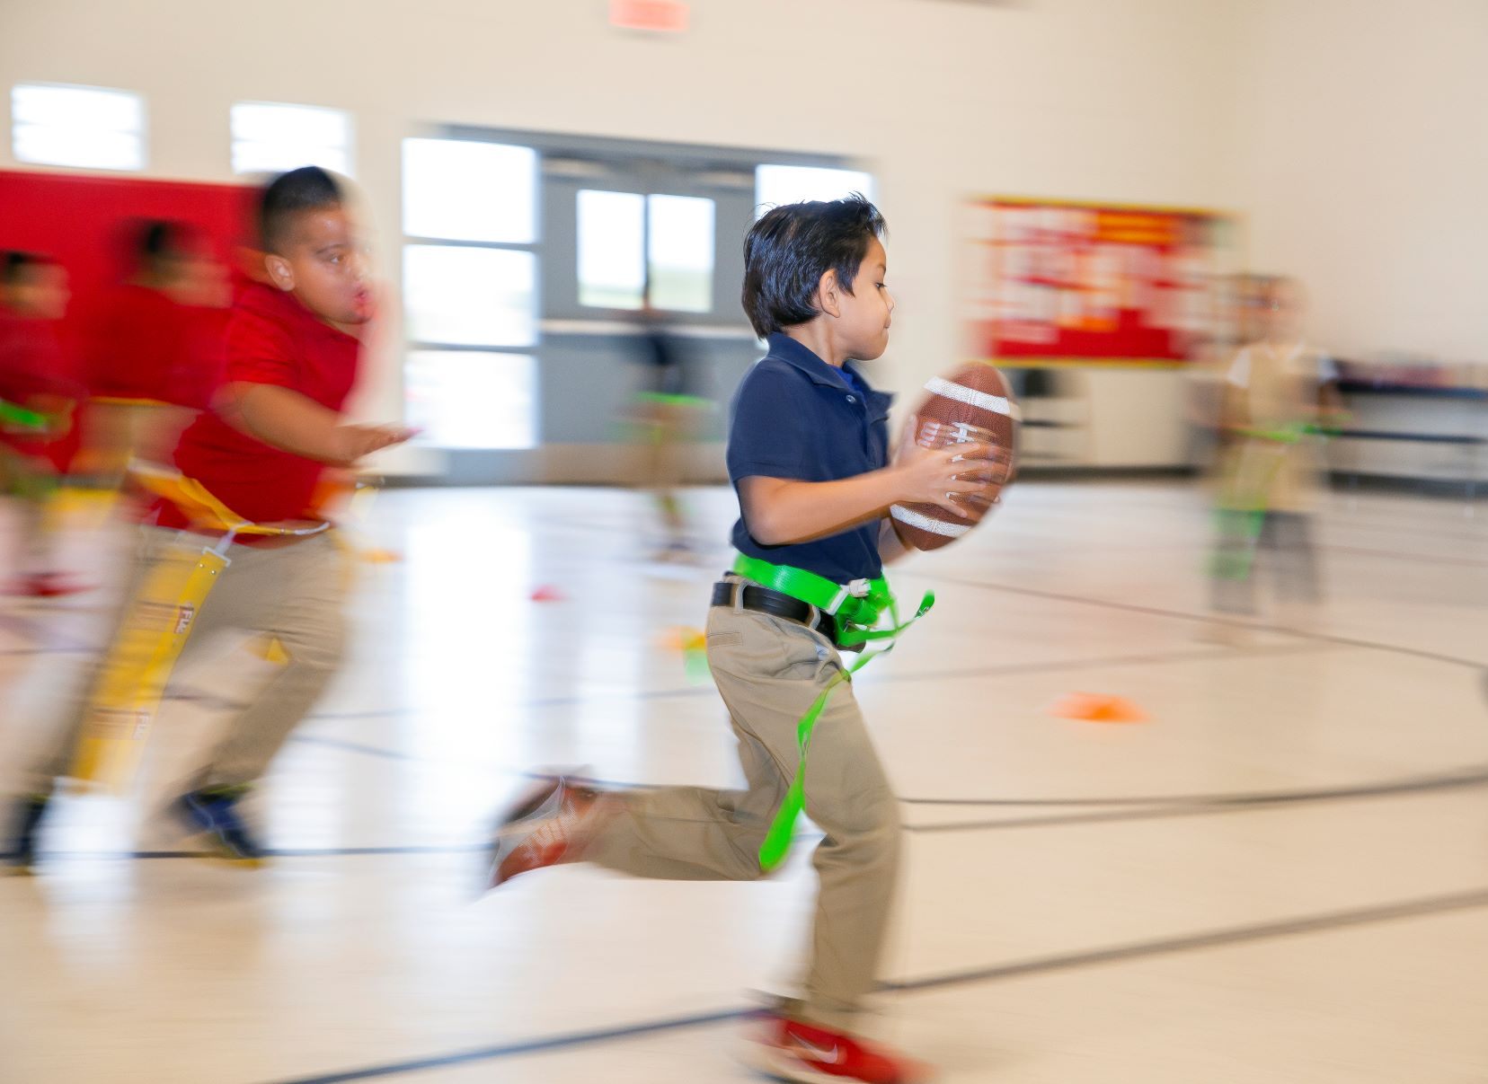
School Wide Specials
Physical Education
Technology
Leader in Me
Art/Music

Slide 14
Homework
Homework in all grades Monday – Thursday
Reinforcement of classroom instruction
Homework time at home
Kinder 20- 30 minutes
1st – 2nd 30 minutes
3rd – 6th 30 – 45 minutes
7th – 8th 30 minutes per subject

Slide 15
Title I Intervention and Support For Scholars
K-8 Reading and Math Intervention for scholars
Tutoring
Intersession school
Saturday school
AzM2 testing bootcamps
Special Education
ELL services
Partnering with you

Slide 16
Attendance
Dress Code
Schoolwide Management

Slide 17
Attendance
Attendance is required and will be taken daily by teachers.
Attendance is monitored through our Attendance Clerk and Dean of Students.
In the virtual model, teachers will verify attendance through a combination of the following:
1. Logging into Edgenuity for at least 30 minutes per day
2. Being present for at least one daily Zoom/Google Meets meeting
3. Actively completing assignments daily in Google Classroom

Slide 18
Dress Code
Tops (Boys and Girls)
Solid navy blue, red, or white polo-style or button-up shirts are acceptable.
Shirts must be tucked in at all times.
Bottoms
Boys: Plain, dark navy blue or khaki bottoms (shorts or pants).
Girls: Plain, dark navy blue or khaki bottoms (shorts, skorts, jumper, pants).

Slide 19
Dress Code
Jackets/Sweaters (Boys and Girls)
Inside the building: Solid red, navy blue, white, or gray
Outside the building: Any design and color
Hairstyles
Hair shall be neatly groomed.
Appropriate hairstyles and cuts, as well as natural hair colors, are acceptable.
Bangs shall be worn above the eyebrows or pinned away from the eyes.

Slide 20
School-Wide Management
School-wide expectations for all K-8 scholars
Seven level discipline process
Positive reinforcement and redirection
Learning moments, consequences, counseling, placement
Partner with families and the community

Slide 21
Stay Informed
Stay Connected

Slide 22
Family Communication
Class Dojo
PowerSchool Parent Portal
Phone, email, in person, and conferences

Slide 23
Social Media
School Web page: http://sunvalleycharter.com , http://sunvalleyacademy.org
Sun Valley Academy Facebook page:https://www.facebook.com/SunValleyAcademy/
Sun Valley Academy Preschool Facebook https://www.facebook.com/sunvalleypreschool/
Sun Valley Academy Twitter https://twitter.com/SunValleySchool
Sun Valley Instagram
https://www.instagram.com/sunvalleyacademy/

Slide 24
How Can I Help? Volunteers Needed!
Volunteer to be a Room Parent
Help at school events
Be a classroom volunteer
Donate needed items throughout the year
Cut/make things at home
Chaperone for a field trip

Slide 25
We Work Hard! But, We Still Have Fun!!
Field Trips
Science Fair Projects
Special Event Days
Award Assemblies
Contests
Sports
Concerts
And much more!!!

Slide 26
Upcoming Events:
September 7 Labor Day - No School
September 18 Progress Reports Go Home
September 30 LIM Training (SM Campus Only) Teachers not offering live sessions -
Video/virtual lessons and activities will continue for scholars.

Slide 27
Thank you! Next Stop Teacher Time
South Mountain Campus -
Principal: Ms. Amy Austin
aaustin@sunvalleyacademy.org
Dean of Students: Dr. Marshall Morris
mmorris@sunvalleyacademy.org
Avondale Campus -
Principal: Ms. Ashlynn Johnson
ajohnson@svavondale.org
Dean of Students: Mrs. Katrina Baker
kbaker@svavondale.org

